Slide 1
Modeling methods
UNIT - 3
Part-1 : Choosing and evaluating models
Mapping problems to machine learning tasks.
Evaluating models
Validating models

Slide 2
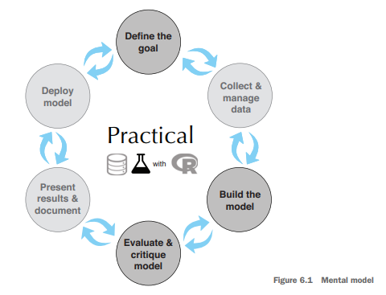
Modeling Methods
Definition: Focuses on statistical and machine learning methods to answer business questions by building and evaluating models.

Slide 3
1. Mapping problems to machine learning tasks
As a data scientist, your role is to convert a business problem into the most suitable machine learning (ML) approach to get meaningful, accurate, and actionable results.
Example: Online Retail Company Problems
Possible tasks you might handle:
Predict what customers might buy based on past purchases.
Detect fraudulent transactions.
Measure price elasticity – how price changes affect sales.
Find the best way to display product listings in search results.
Segment customers with similar buying behavior.
Determine AdWord value (how much to spend on ads).
Assess marketing campaign performance.
Classify new products into categories.

Slide 4
The purpose of the model strongly influences which method you choose:
To know how small changes in inputs affect outputs → use Regression.
To know which single variable drives classification → use Decision Trees.
Different problems naturally suggest different statistical/ML approaches.

Slide 5
Three Main Categories of Problems
Classification – Assigning labels to items.
  Example: Spam / Not spam, Product category tagging.
  Output: Category/label.
  Type: Supervised learning (needs labeled data).
Scoring – Assigning a numeric value or probability to items.
  Example: Predicting sales amount, probability of fraud.
  Output: Number or probability.
  Type: Supervised learning (needs historical data with known outcomes).
Grouping – Finding patterns and similarities without known labels.
  Example: Customer segmentation, product grouping.
  Output: Clusters/groups.
  Type: Unsupervised learning (no labeled data needed).

Slide 6
1.1 Classification problems
Classification assigns a category label to each data point. It is used when the output you want to predict is a fixed set of possible classes.
Needs a training set with examples where the correct label is already known (supervised learning)
Each row in the data contains input features and the correct category label
The model learns patterns in the training data to assign labels to new, unseen cases
Examples in business:
  Determining if an email is spam or not
  Assigning a product to a product category
  Predicting if a customer will default on a loan
Binary classification: two possible labels (spam/not spam)
Multiclass classification: more than two labels (product type A, B, C, etc.)
Some algorithms are designed for binary classification but can be adapted for multiclass tasks
Methods commonly used: logistic regression, decision trees, random forests, support vector machines, naive Bayes
Quality of the classifier depends heavily on quality and quantity of labeled training data

Slide 7
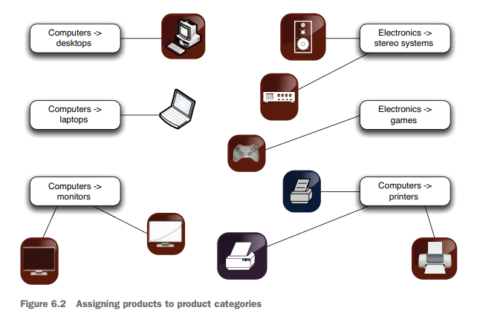
Example

Slide 8
1.2 Scoring problems
Scoring problems assign a numeric value to each data point. This value can be a direct numerical prediction or a probability between 0 and 1.
Often called regression problems when predicting continuous numbers
Require historical data with known numeric outcomes (supervised learning)
Output can be:
1. Continuous value (e.g., sales in dollars, temperature in °C)
2. Probability (e.g., chance of fraud, likelihood of purchase)
Examples in business:
1. Predicting additional sales from a marketing campaign
2. Estimating the probability a transaction is fraudulent
3. Predicting final auction price of a product
4. Estimating the chance a customer will repay a loan
Methods commonly used:
1. Linear regression
2. Regularized regression (ridge, lasso)
3. Tree-based regression methods
Model quality is evaluated using metrics such as RMSE (root mean squared error) or R² (coefficient of determination) for continuous outcomes
For probabilities, additional evaluation methods include log-likelihood, AUC, and calibration plots

Slide 9
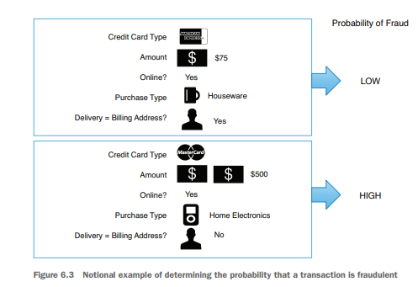
Example

Slide 10
1.3 Grouping problems
Grouping problems find patterns, similarities, or structures in data without using predefined labels. These are unsupervised learning problems.
No labeled output variable in the training data
Goal is to uncover relationships or natural divisions within the dataset
Common types:
1. Clustering – grouping similar data points together
2. Association rules – finding items or events that often occur together
Examples in business:
1. Customer segmentation based on purchase behavior
2. Grouping products with similar sales patterns
3. Market-basket analysis to discover products often bought together
Methods for clustering:
1. k-means clustering
2. Hierarchical clustering
3. DBSCAN
Methods for association rules:
1. Apriori algorithm
2. FP-growth algorithm
Outputs from clustering can guide marketing strategies, product recommendations, and targeted promotions
Association rules can drive recommendations (e.g., “people who bought X also bought Y”)

Slide 11
When to use basic clustering
Suppose you want to segment your customers into general categories of people with similar buying patterns. You might not know in advance what these groups should be.
This problem is a good candidate for k-means clustering.
K-means clustering is one way to sort the data into groups such that members of a cluster are more similar to each other than they are to members of other clusters.
Suppose that you find (as in figure 5.4) that your customers cluster into those with young children, who make more family-oriented purchases, and those with no children or with adult children, who make more leisure- and social-activity-related purchases.
Once you have assigned a customer into one of those clusters, you can make general statements about their behavior.
For example, a customer in the with-young-children cluster is likely to respond more favorably to a promotion on attractive but durable glassware than to a promotion on fine crystal wine glasses.

Slide 12
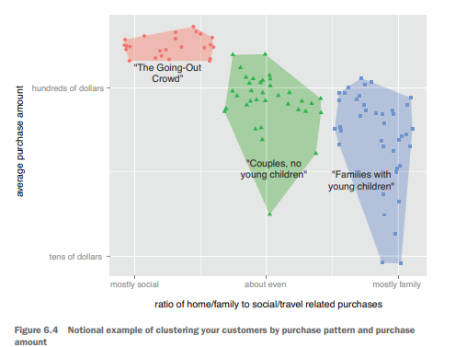
Example
Suppose that you find (as in figure 6.4) that your customers cluster into those with young children, who make more family-oriented purchases, and those with no children or with adult children, who make more leisure- and social-activity-related purchases. Once you have assigned a customer into one of those clusters, you can make general statements about their behavior. For example, a customer in the with-young children cluster is likely to respond more favorably to a promotion on attractive but durable glassware than to a promotion on fine crystal wine glasses.

Slide 13
When to use association rules:
Purpose: Find items or events that commonly occur together
Examples:
  Products purchased at the same time
  Products purchased by customers with specific characteristics
  Products bought within a certain time period
Example business case:
  People who buy bathing suits often also buy sunblock
  Use insight to suggest sunblock or place it near bathing suits in-store or online
Market-basket analysis: discovering products frequently bought together
Recommending complementary products to customers
Identifying purchase patterns for product placement in stores or online
Analysing website click stream data to find common navigation paths
Detecting co-occurrence of medical symptoms or diagnoses in healthcare data

Slide 14
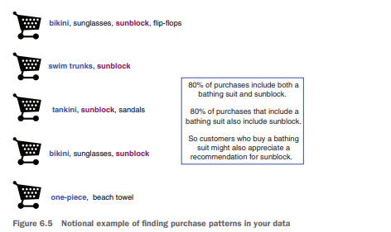

Slide 15
Problem-to-method mapping
Example tasks | Machine learning terminology | Typical algorithms
Identifying spam email Sorting products in a product catalog Identifying loans that are about to default Assigning customers to preexisting customer clusters | Classification: assigning known labels to objects | Decision trees Naive Bayes Logistic regression (with a threshold) Support vector machines
Predicting the value of AdWords Estimating the probability that a loan will default Predicting how much a marketing campaign will increase traffic or sales | Regression: predicting or forecasting numerical values | Linear regression Logistic regression
Finding products that are purchased together Identifying web pages that are often visited in the same session Identifying successful (much-clicked) combinations of web pages and AdWords | Association rules: finding objects that tend to appear in the data together | Apriori

Slide 16
Problem-to-method mapping
Example tasks | Machine learning terminology | Typical algorithms
Identifying groups of customers with the same buying patterns Identifying groups of products that are popular in the same regions or with the same customer clusters Identifying news items that are all discussing similar events | Clustering: finding groups of objects that are more similar to each other than to objects in other groups | K-means
Making product recommendations for a customer based on the purchases of other similar customers Predicting the final price of an auction item based on the final prices of similar products that have been auctioned in the past | Nearest neighbor: predicting a property of a datum based on the datum or data that are most similar to it | Nearest neighbor

Slide 17
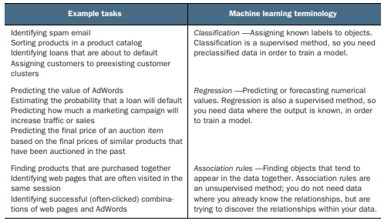
Problem-to-method mapping
This table maps some typical business problems to their corresponding machine learning tasks.

Slide 18
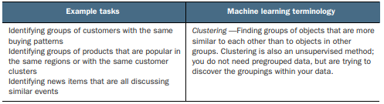
Contd..

Slide 19
2. Evaluating models
Model evaluation is the process of estimating how well a model will perform on new, unseen data.
Key points:
Purpose: ensure the model performs well in real-world use, not just on training data
Common approach: split data into training set and test set (see figure 6.6)
  Training data – used to fit the model
  Test data – kept separate during training, used only for final evaluation
The test set helps estimate how the model will behave with new data
Helps detect overfitting:
  Overfitting occurs when a model memorizes training data patterns instead of learning general rules
  An overfit model performs well on training data but poorly on new data
Looking for signs of overfitting is an important first diagnostic step

Slide 20
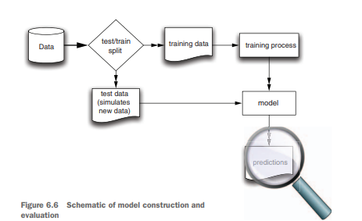

Slide 21
Definition: Model evaluation estimates generalization error — how model performs on new data.
Train/Test split: reserve holdout data for final evaluation; don’t tune on test set.
Typical splits: 70/30 or 80/20 (50/50 possible for huge data).
Overfitting: model memorizes training quirks — minimal train error but large test error.
  Prefer simpler models; use regularization and bagging to reduce variance.
When to use cross-validation: small datasets or when tuning hyperparameters.
  Use k-fold CV (k=5 or 10 common).

Slide 22
2.1 Overfitting
Overfitting occurs when a model performs extremely well on training data but poorly on new, unseen data.
It memorizes specific patterns from the training data rather than learning general rules.
Training error: prediction error on training data
Generalization error: prediction error on new (test) data
Training error is usually smaller than generalization error
Ideally, these two error rates should be close
Large gap between them indicates possible overfitting
Simpler models often generalize better
Problems with overfitting:
Model is more complex than necessary (e.g., unnecessary fluctuations in figure 6.7)
Harder to optimize or interpret
Lower accuracy in real-world use compared to training phase
Can be embarrassing in production

Slide 23
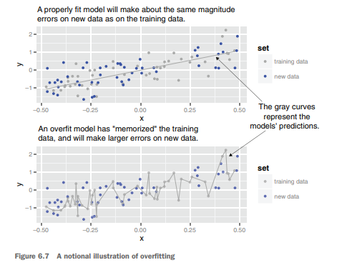
Comparison of a reasonable model vs an overfit model

Slide 24
Testing on held-out data:
Splitting data into training, calibration, and test sets helps detect overfitting
If you train and test on the same data:
  You get overly optimistic performance estimates (optimistic measurement bias)
  Model tuning may exploit quirks in the training data (multiple comparison bias)
Recommendation:
  Keep test data separate and untouched until final evaluation
  Do all experimentation and tuning on training data only
Typical splits:
  70% training, 30% test
  80% training, 20% test
  Large datasets: sometimes 50% training, 50% test

Slide 25
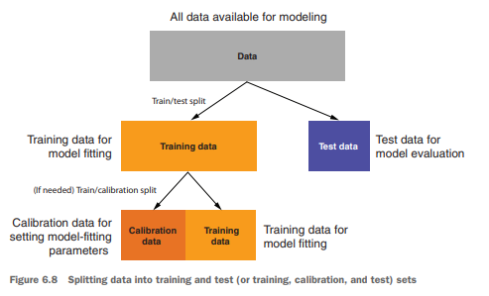
Train/calibration/test data split

Slide 26
2.1 K-fold cross-validation
K-fold cross-validation is a method of evaluating model performance by repeatedly training and testing on different partitions of the data
so every example is used for both training and testing (but never in both roles at the same time).
Key points:
Limitation of a simple train/test split:
  Each example is used only once for training or testing
  Test set is often much smaller, leading to less precise performance estimates
Useful when the dataset is small and you can’t afford to hold out a large test set

Slide 27
Process for k-fold CV (example: k = 3, see figure 6.9):
Split the data into k non-overlapping partitions (folds)
For each fold:
  Train the model on k-1 folds
  Test it on the remaining fold
Repeat until each fold has served as the test set exactly once
Combine all predictions from the test folds and calculate evaluation metrics
Benefits:
More precise estimate of model performance than a single holdout split
Uses all data for both training and testing
→ After CV, train the final model using all available training data.
In big datasets:
A simple train/test split is usually sufficient and faster
Common uses of k-fold CV in practice:
Tuning model parameters (hyperparameter optimization)
Nesting models (output of one model as input to another)

Slide 28
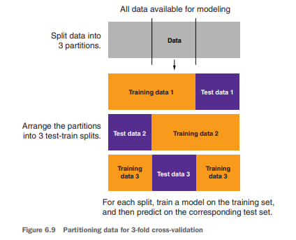

Slide 29
2.2 Measures of model performance
Definition/Introduction:
Measures of model performance are quantitative metrics used to evaluate how well a model works. Models can be grouped into four types:
1. Classification
2. Scoring
3. Probability estimation
4. Clustering
Usually, we compute one or two summary scores to assess if a model is effective by comparing it to baseline models.

Slide 30
Null Model:
A simple baseline model that always predicts the same outcome.
Used as a lower bound for performance.
For classification, it predicts the most common category.
For scoring, it predicts the average outcome.
If your model does not outperform the null model, it adds no value.
Single-Variable Models:
Models based on just one variable.
Your complex model should outperform the best single-variable model.
Business analysts often rely on single-variable models (e.g., pivot tables).
Custom Metrics:
Besides standard metrics, create business-oriented custom metrics, often assigning dollar values to outcomes for evaluation.

Slide 31
2.3 Evaluating classification models
A classification model categorizes examples into two or more classes.
To evaluate the performance of such classifiers, the confusion matrix is an essential tool.
It summarizes how well the classifier predicts categories compared to actual known labels.
As an example, consider classifying emails into spam (unwanted emails) and non-spam (wanted emails).
The "Spambase Data Set" contains feature measurements for each email and labels indicating if the email is spam or not.

Slide 32
Using logistic regression, we build a spam classification model:
The dataset is split into training and test sets.
A logistic regression model is trained on the training data.
Predictions are made on both the training and test data.
A sample of actual and predicted classifications is shown, where probabilities greater than 0.5 indicate spam, and below 0.5 indicate non-spam.

Slide 33
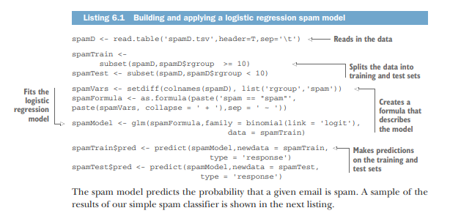

Slide 34
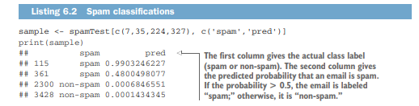

Slide 35
Confusion Matrix
The confusion matrix is a summary table comparing the classifier's predictions against actual known categories. It counts how often each combination of true outcome and predicted outcome occurs.
Rows represent the actual labels (truth).
Columns represent the predicted labels.
For the spam classification example, the confusion matrix has four parts
True Negatives (correctly predicted non-spam)
False Positives (incorrectly predicted spam)
False Negatives (incorrectly predicted non-spam)
True Positives (correctly predicted spam)

Slide 36
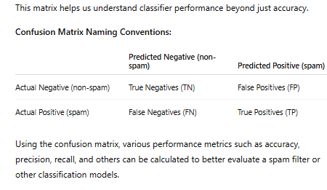

Slide 37
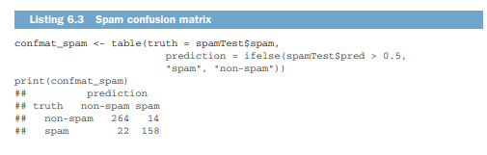
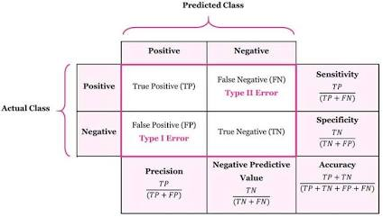
Spam Confusion matrix

Slide 38
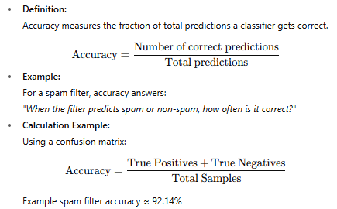
Accuracy in Classification Models

Slide 39
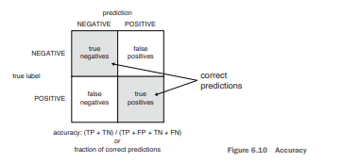
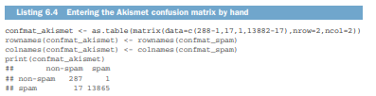

Slide 40
Good vs Poor Classifier Example:
Simple spam filter: Accuracy ≈ 92.1% (8% error, which is high for spam filtering)
Akismet spam filter: Accuracy ≈ 99.87% (much better due to use of additional features)
Limitation of Accuracy:
Accuracy can be misleading when dealing with unbalanced classes (rare events).
Example: Predicting a rare event that occurs in 1% of cases, a model that always predicts "no event" is 99% accurate but useless.
Even a model that identifies 5% at risk and catches all bad events can have lower accuracy but be more valuable.
Conclusion:
Accuracy is a straightforward metric but not appropriate for unbalanced datasets or when costs of errors differ.
Other metrics like precision and recall should be considered for better evaluation in such cases.

Slide 41
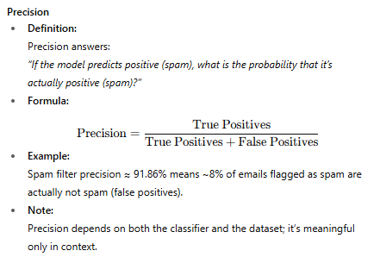
Precision, Recall, and F1 Score in Classification

Slide 42
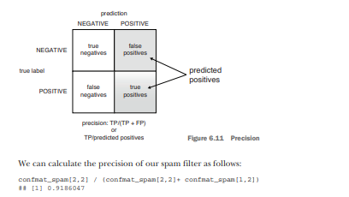
precision of spam filter

Slide 43
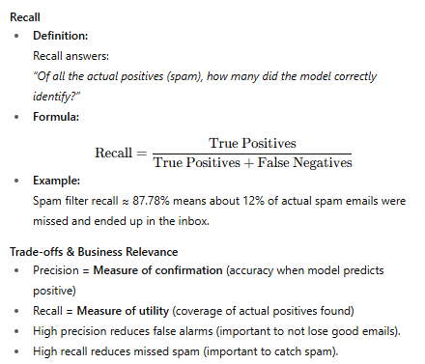

Slide 44
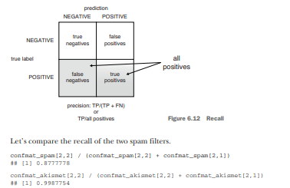

Slide 45
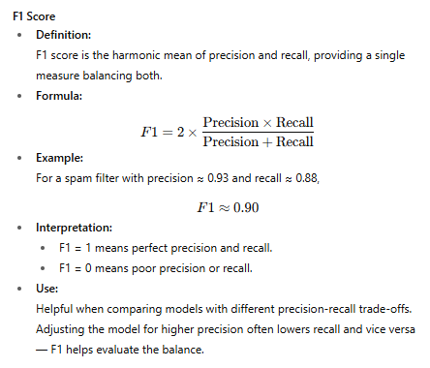

Slide 46
Sensitivity and Specificity
Context
A spam filter trained on one dataset (e.g., work email) might behave differently on another (e.g., personal email) because the proportion (prevalence) of spam can vary.
Metrics like precision and recall depend on this prevalence, so their values can shift when applied to different populations.

Slide 47
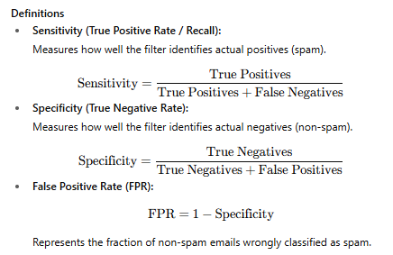
Example Metrics for Spam Filter
1. Sensitivity (Recall) ≈ 88%
2. Specificity ≈ 95% (meaning about 5% of non-spam emails are incorrectly flagged as spam)

Slide 48
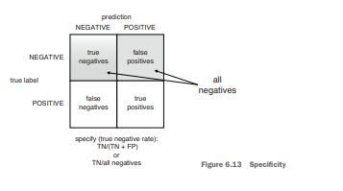
Sensitivity is also called the true positive rate and is exactly equal to recall. Specificity is also called the true negative rate: it is the ratio of true negatives to all negatives. This is shown in figure 6.13.

Slide 49
Important Notes
Sensitivity and specificity are independent of the class prevalence (proportion of spam), making them useful when applying a model to different populations.
Flipping the class labels swaps sensitivity and specificity.
A trivial classifier (always positive or always negative) will score zero on either sensitivity or specificity.
Sensitivity/specificity metrics come from medical testing and other fields where test accuracy needs to be independent of disease prevalence.
Precision/recall are population-dependent and give insight into how the classifier performs on the actual distribution of classes.
Why Both?
Sensitivity/Specificity: Best for understanding inherent test/filter accuracy regardless of class distribution.
Precision/Recall: Best for understanding performance in a specific population with a given class distribution.

Slide 50

Summary: Using Common Classification Performance Measures
Using Classification Performance Measures :
Discuss with clients which metric matters most for their business.
Confirm if they want that metric to be high.
Run a quick thought experiment to ensure clear understanding.
Set project goals as minimum thresholds on key metrics.
Different problems require focusing on different scores (e.g., precision vs recall).

Slide 51
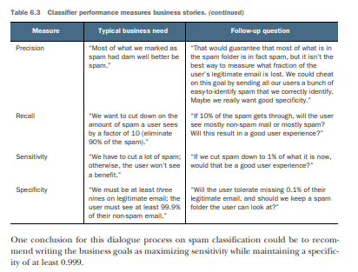

Slide 52
2.4 Evaluating scoring models
In machine learning, a scoring model is one that predicts a continuous numerical value rather than a category.
Examples:
Predicting house prices from size, location, and amenities.
Predicting temperature from cricket chirp rate.
Predicting customer lifetime value from transaction history.
These models output a number — a score — instead of “class labels” like spam or not spam.

Slide 53
Difference from Classification Evaluation
Classification models use metrics like accuracy, precision, recall, F1.
Scoring models use metrics like RMSE and R², which focus on the magnitude of errors and explained variance.
These metrics have the same units as the target or are unitless ratios for easier interpretation.

Slide 54
Example
Hypothesis: Cricket chirp rate is proportional to temperature.
Collected data → Chirp rate (chirps/sec) vs Temperature (°F).
Goal → Fit a regression model to predict temperature from chirp rate.
Data file: crickets.csv
Model: Linear regression (lm() in R).

Slide 55
Step 1 – Fit and Predict
crickets <- read.csv("cricketchirps/crickets.csv")
# Fit linear regression model
cricket_model <- lm(temperatureF ~ chirp_rate, data=crickets)
# Predict temperature
crickets$temp_pred <- predict(cricket_model, newdata=crickets)
The predictions (temp_pred) are compared to the actual measured temperatureF.
Step 2 – Residuals
Residuals = actual value – predicted value.
Show difference between what happened and what model predicted.
Figure 6.14 – Plots:
Points = actual data
Line = model predictions
Vertical gaps between points and line = residuals.

Slide 56
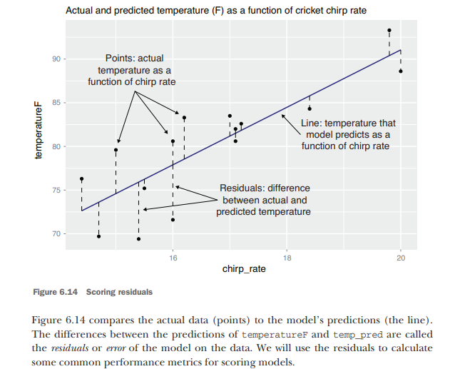

Slide 57
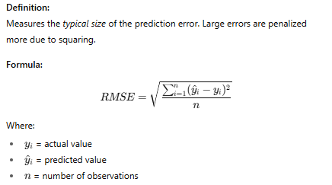
Root Mean Square Error (RMSE)
Two Main Metrics for Scoring Models
Root Mean Square Error (RMSE)
R-Squared (R² – Coefficient of Determination)

Slide 58
Calculation (Listing 6.7):
error_sq <- (crickets$temp_pred - crickets$temperatureF)^2
RMSE <- sqrt(mean(error_sq))
# Result: 3.564149
Interpretation:
RMSE ≈ 3.56°F → on average, predictions are off by about 3.6°F.
Same units as target variable (here °F).
Smaller RMSE = better model fit.
In this example, if your goal is predictions within ±5°F → this model is acceptable.
Business Use Example:
“We want RMSE on account valuation to be under $1,000 per account.”

Slide 59
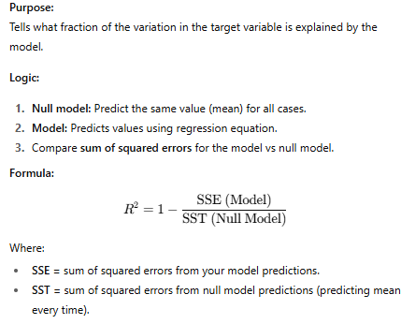
R-Squared (R² – Coefficient of Determination)

Slide 60
Calculation (Listing 6.8):
error_sq <- (crickets$temp_pred - crickets$temperatureF)^2
numerator <- sum(error_sq) # Model SSE
delta_sq <- (mean
(crickets$temperatureF) - crickets$temperatureF)^2
denominator <- sum(delta_sq) # Null model SSE
R² <- 1 - numerator/denominator
# Result: 0.6974651

Slide 61
Interpretation:
R² ≈ 0.697 → model explains ~70% of the variation in temperature.
Higher R² → better explanatory power.
Negative R² → model is worse than the null model.
For regression with one predictor, R² often equals the square of the correlation coefficient.
Business Use Example:
“We want the model to explain at least 70% of variation in account value.”

Slide 62
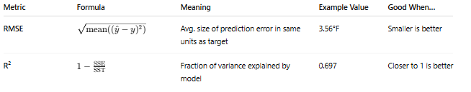
Summary table

Slide 63
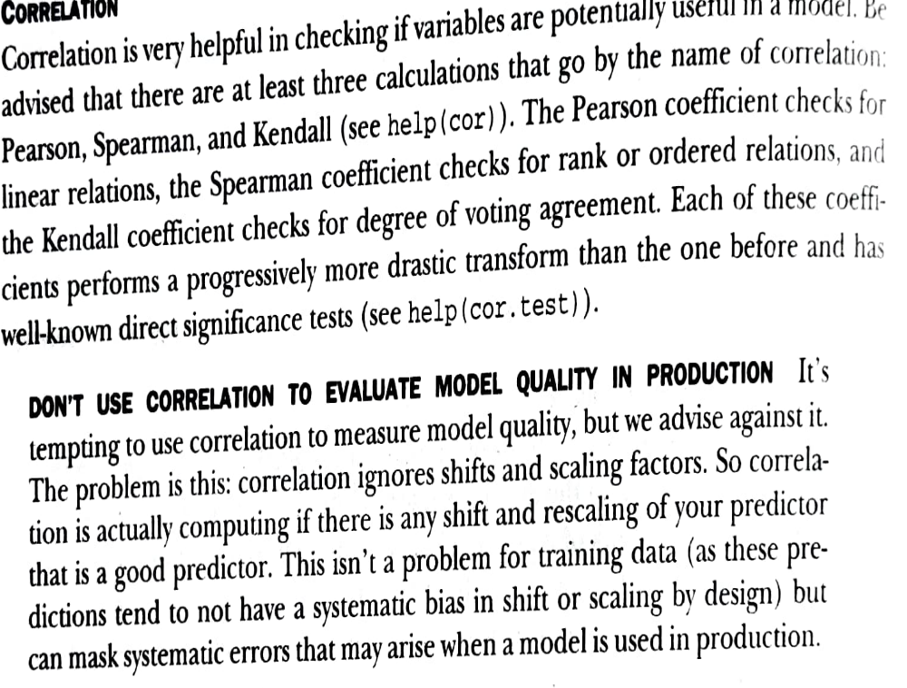


Slide 64
Evaluating scoring models
Evaluating models that assign scores can be a some what visual task.
The main concept is looking at what is called the residuals or the difference between our predictions f(x[i,]) and actual outcomes y[i].
d <- data.frame(y=(1:10)^2,x=1:10)
model <- lm(y~x,data=d)
d$prediction <- predict(model,newdata=d)
library('ggplot2') ggplot(data=d) + geom_point(aes(x=x,y=y)) + geom_line(aes(x=x,y=prediction),color='blue') + geom_segment(aes(x=x,y=prediction,yend=y,xend=x)) + scale_y_continuous('')

Slide 65
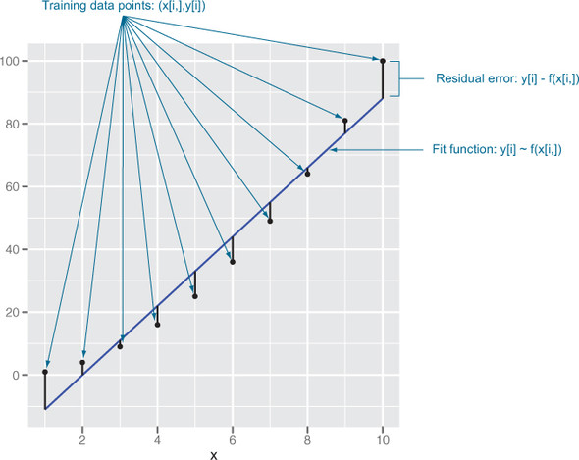

Slide 66
Correlation
Correlation is very helpful in checking if variables are potentially useful in a model.
there are three calculations that go by the name of correlation:
Pearson, Spearman, and Kendall (see help(cor)).
The Pearson coefficient checks for linear relations
the Spearman coefficient checks for rank or ordered relations
the Kendall coefficient checks for degree of voting agreement.
Each of these coefficients performs a progressively more drastic transform than the one before and has well-known direct significance tests (see help(cor.test)).

Slide 67

cor() function in R programming measures the correlation coefficient value. Correlation is a relationship term in statistics that uses the covariance method to measure how strongly the vectors are related.
Mathematically,
Where:
x represents the x data vector
y represents the y data vector
xˉxˉ represents mean of x data vector
yˉyˉ​ represents mean of y data vector
N represents total observations

Slide 68
Syntax:
cor(x, y, method)
Where:
x and y represents the data vectors
method defines the type of method to be used to compute covariance.
Default is "pearson".
x <- c(1, 3, 5, 10)
y <- c(2, 4, 6, 20)
print(cor(x, y))
print(cor(x, y, method = "pearson"))
print(cor(x, y, method = "kendall"))
print(cor(x, y, method = "spearman"))
Output:
[1] 0.9724702
[1] 0.9724702
[1] 1
[1] 1

Slide 69
These techniques explore relationships between variables:
Correlation Analysis:
Measures the strength and direction of relationships using cor().
Regression Analysis:
Models relationships using lm()(linear regression).
# Correlation Analysis using cor(): Measure the strength and direction of a linear relationship
x <- c(1, 2, 3, 4, 5)
y <- c(5, 4, 3, 2, 1)
correlation_result <- cor(x, y)
print("Correlation Between x and y:")
print(correlation_result)
[ 1] "Correlation Between x and y:"
[1] -1

Slide 70
Absolute Error
For many applications, those involving predicting monetary amounts measures such as
absolute error = (sum(abs(d$prediction-d$y))),
mean absolute error = (sum(abs(d$prediction-d$y))/length(d$y)), and
relative absolute error =
(sum(abs(d$prediction-d$y))/sum(abs(d$y))) are utilized

Slide 71
2.5 Evaluating Probability Models
Introduction
Probability models predict the likelihood that an observation belongs to a certain class, rather than predicting the class directly.
Examples:
Spam filter predicting P(email is spam).
Medical test predicting P(patient has disease).
Credit scoring model predicting P(customer defaults).
These models are especially useful when:
Decisions depend on risk thresholds (e.g., flag only if risk > 0.8).
You want to balance between false positives and false negatives.

Slide 72
Main Evaluation Tools
Double Density Plot
ROC Curve & AUC
Log Likelihood (LL)
Deviance & Pseudo R²

Slide 73
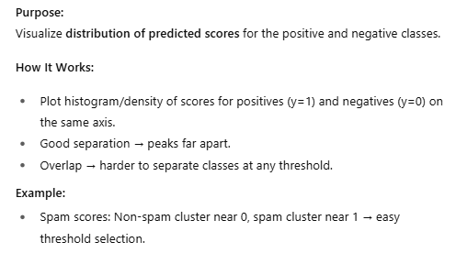
Double Density Plot

Slide 74
Listing 6.9 – Code to create double density plot.
Code:
library(WVPlots)
DoubleDensityPlot(spamTest, xvar = "pred", truthVar = "spam", title = "Distribution of scores for spam filter")
->Plots probability score distributions for both classes.

Slide 75
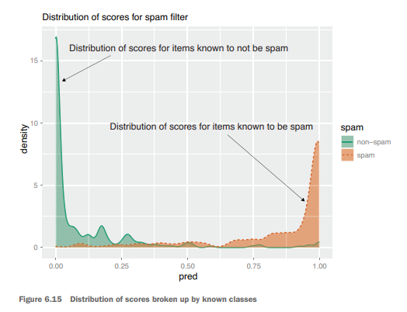
Figure 6.15 – Example: Spam vs non-spam score distributions.
Double Density Plot: Shows score distributions for positives & negatives. Less overlap = better separation.

Slide 76
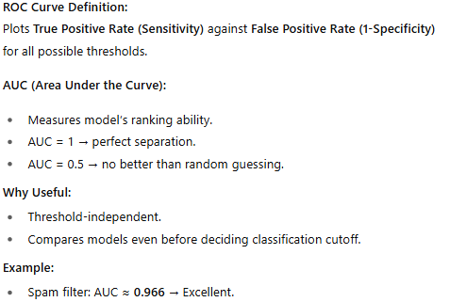
ROC Curve & AUC

Slide 77
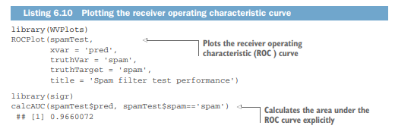
Listing 6.10 – Plot ROC and compute AUC.
Calculates and plots ROC curve, computes AUC score.

Slide 78
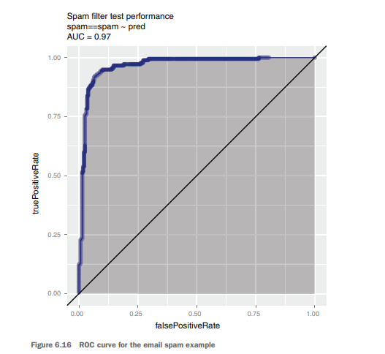
Figure 6.16 – ROC for spam filter.
Higher curve = better ranking ability. AUC ≈ 0.966 means excellent separation.

Slide 79
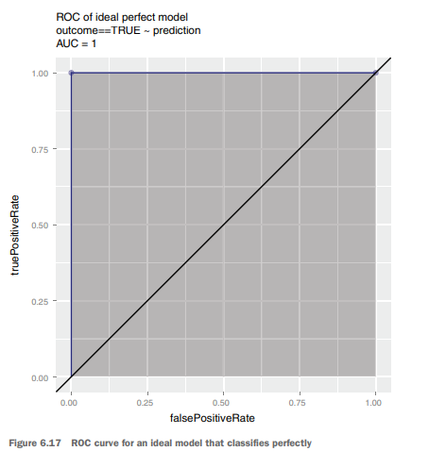
Figure 6.17 – ROC for perfect model.
Ideal top-left shape, AUC = 1.0.

Slide 80
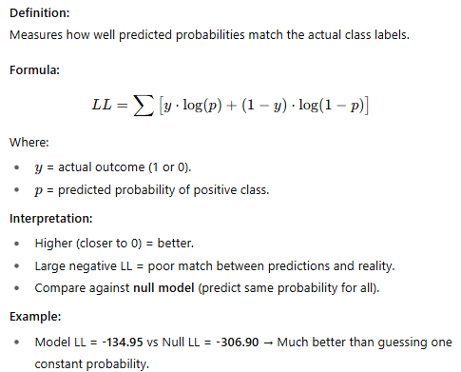
Log Likelihood (LL)

Slide 81
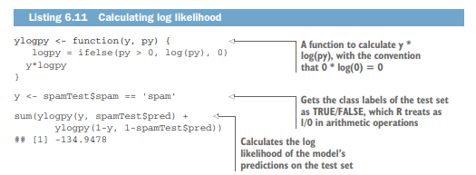
Listing 6.11 – Calculating log likelihood.
Calculates how well predicted probabilities match actual outcomes.

Slide 82
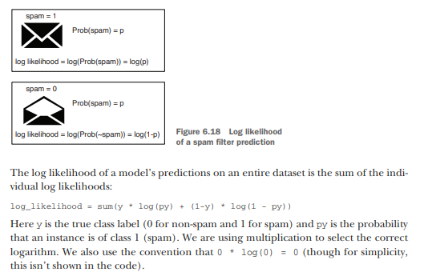
Figure 6.18 – Concept of LL.
Higher likelihood = predictions match actual outcomes better.

Slide 83
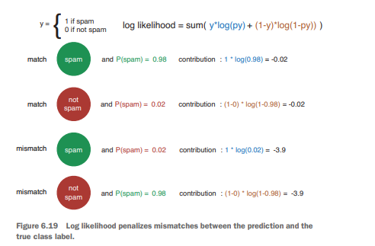
Figure 6.19 – Penalty curves for wrong predictions.
Wrong confident predictions get heavy penalties.

Slide 84
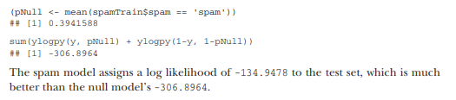
Listing 6.12 Computing the null model’s log likelihood
Measures improvement from null model; high pseudo R² = better fit.

Slide 85
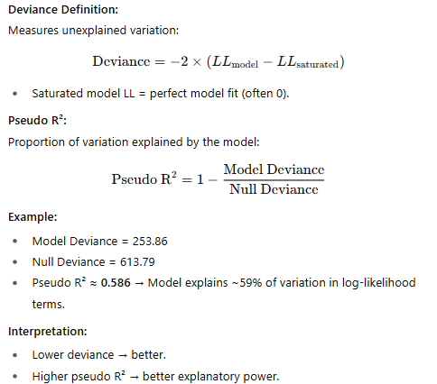
Deviance & Pseudo R²

Slide 86
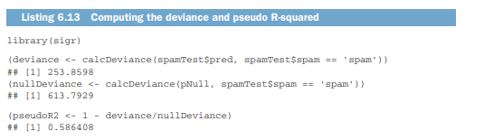
Listing 6.13 Computing the deviance and pseudo R-squared

Slide 88
UNIT-3_Part-2
Memorization Methods:
KDD and KDD Cup 2009
Building single-variable models
Building models using many variables

Slide 89
Memorization methods generate answers by returning a majority category (in the case of classification)
or average value (in the case of scoring) of a subset of the original training data.
These methods can vary from models depending on a single variable (similar to the analyst’s pivot table), to decision trees ,nearest neighbour and Naivebayes.

Slide 90
KDD and KDD Cup 2009
The Conference on Knowledge Discovery and Data Mining (KDD) is the premier conference on machine learning methods.
Every year KDD hosts a data mining cup, where teams analyze a dataset and then are ranked against each other.
The KDD Cup is a huge deal and the inspiration for the famous Netflix Prize and even Kaggle competitions.
The KDD Cup 2009 provided a dataset about customer relationship management.
The contest supplied 230 facts about 50,000 credit card accounts.
From these features, the goal was to predict account cancellation (called churn), the innate tendency to use new products and services (called appetency), and willingness to respond favorably to marketing pitches (called upselling).

Slide 91
As with many score-based competitions, this contest concentrated on machine learning and deliberately abstracted or skipped over a number of important data science issues
cooperatively defining goals, requesting new measurements, collecting data, and quantifying classifier performance in terms of business goals.
In fact, for this contest we don’t have names or definitions for any of the independent (or input) variables and no real definition of the dependent (or outcome)

Slide 92
Introduction: KDD Cup 2009
What is KDD Cup?
KDD Cup is an annual competition organized as part of the Knowledge Discovery and Data Mining (KDD) conference.
It provides real-world datasets and challenges for researchers and practitioners to test data mining and machine learning techniques.
Each year, the task is different (e.g., biology, e-commerce, banking, etc.).

Slide 93
The 2009 Challenge
Problem: Predict which credit card accounts would be canceled within a given time period.
In business terms, this is a customer churn prediction problem.
Churn means when a customer stops using a service (in this case, cancels their credit card account).
The cancellation event is the outcome variable (also called the dependent variable).

Slide 94
Example
We are given the task of predicting which credit card accounts will cancel in a given time period.
This sort of cancellation is called churn.
To build our model, we have supervised training data available.
For each account in the training data, we have hundreds of measured features and we know whether the account later cancelled.
We want to build a model that identifies “at risk of canceling” accounts in this data, as well as for future applications

Slide 95
Dataset Description
Each account (row) has:
  Hundreds of measured features (input variables) → details about the customer/account.
  Outcome (dependent variable) → whether the account was canceled.
The dataset is supervised (both inputs and outcomes are known for training).
Real-world like data: noisy, imbalanced, and lacks full context.

Slide 96
Objective
Build a model that can:
  Identify “at risk of cancellation” accounts in the dataset.
  Generalize well for future applications (predict churn for new customers).
Importance of the Problem
Customer churn prediction is crucial for:
  Banks/Financial Institutions → Retain valuable customers.
  Telecom & Subscription services (e.g., Netflix, Amazon Prime, Spotify) → Prevent users from canceling.
  Business Growth → Cheaper to retain customers than acquire new ones.

Slide 97
Shortcomings of KDD Cup 2009 Dataset:
Missing business context → Ignores real-world decision factors like costs, cooperation, or business goals.
No names/definitions for input variables → Features are just numbers (V1, V2…), making interpretation impossible.
Outcome variable lacks explanation → We only know if churn happened, but not the reason behind it.
Cannot use time/repetition-based methods → No timestamps or event history, so time series or survival analysis can’t be applied.
Pre-processed, ready-to-model → Data is fixed in tabular form, so it can’t be joined with external sources for richer insights.

Slide 98
Evaluation Metric: AUC
In KDD Cup 2009, models were judged not by plain accuracy but by a better metric: AUC (Area Under the ROC Curve)
Accuracy not reliable for imbalanced data → High accuracy may just mean the model predicts the majority class.
ROC Curve → plots True Positive Rate vs False Positive Rate → Shows how well the model separates positives from negatives.
AUC = probability model ranks a churned account higher than a non-churned one → Measures model’s overall ranking ability.
Range: 0.5 = random, 1.0 = perfect → Closer to 1 means a stronger predictive model.
Best model in KDD 2009 → AUC = 0.76 → Model could separate churners fairly well but not perfectly.

Slide 99
Data Preparation & Splitting
Before building models, the dataset must be cleaned, labeled, and divided into proper groups.
Loading the Data
  Dataset provided in compressed text format.
  Use R code to load and handle missing values (NA).
Adding Outcome Variable (Churn)
  Churn labels stored separately.
  Need to merge with the main dataset.
  Values: 1 = canceled, -1 = not canceled.
Splitting the Data
  Data divided into Train, Calibrate, and Test sets.
  Training Set → Build model.
  Calibration Set → Detect overfitting & tune model.
  Test Set → Final evaluation of performance.
  Typical split: 80% train, 10% calibration, 10% test.
Why Splitting is Important
  Prevents model from memorizing (overfitting).
  Ensures fairness when evaluating results.

Slide 100
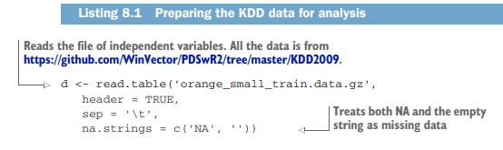
Loading the Data

Slide 101
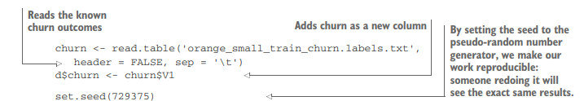
Churn
churn <- read.table(...)
  Reads the churn outcome labels file.
  Each row in this file corresponds to whether a customer account was canceled (1) or not canceled (-1).
  header = FALSE → No column names in the file.
  sep = '\t' → Data values are separated by a tab character.
d$churn <- churn$V1
  Adds the churn column into the main dataset d.
  churn$V1 → Refers to the first column of the churn labels file.
  Now each customer record in dataset d has an outcome label attached.
set.seed(729375)
  Sets a random seed for reproducibility.
  Ensures that any random process (like splitting data into train/test sets) gives the same result every time the code is run.
  Important in competitions: so results can be replicated by others.

Slide 102
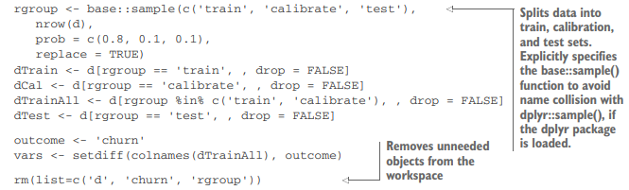
Splitting the Data
Splitting Dataset
Randomly divide data: Train (80%), Calibrate (10%), Test (10%).
Training Set → Build model.
Calibration Set → Tune model, detect overfitting.
Test Set → Final unbiased evaluation.
Define outcome variable (churn) and features (vars).
Remove unused objects to keep workspace clean.

Slide 103
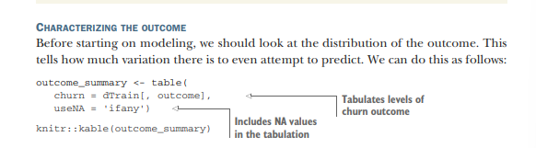

Characterizing the Outcome

Slide 104
Characterizing the Outcome (Churn Distribution)
Before building models, we need to understand the target variable (churn).
In the KDD 2009 dataset, only about 7% of customers churned (left).
About 93% stayed (did not churn).
This shows that the data is highly imbalanced → there are far fewer churners compared to non-churners.
Why it matters:
If we train a model directly, it may predict "No churn" most of the time and still get high accuracy (93%), but it won’t be useful.
That’s why AUC (instead of accuracy) is used as the evaluation metric.
It helps us focus on correctly identifying churners (the smaller but more important group).

Slide 105
The data is imbalanced:
  37,110 non-churners (93%)
  2,943 churners (7%)
If we always predict "No churn", the model will be 93% accurate — but that’s useless, because it completely ignores the important minority (churners).
Simplified summary
Step 1: Count churn vs. non-churn.
Step 2: Churn rate = Churners ÷ Total customers.
Step 3: Churn rate = 7% → very imbalanced data.
Lesson: The dataset shows that only about 7% of customers churn, while 93% stay, making it highly imbalanced. This means a model could appear 93% accurate just by predicting “no churn,” but it would be useless for finding actual churners. Therefore, accuracy is not a good measure here, and better evaluation methods like AUC should be used.

Slide 106
Building a Model – Variable Selection
1. Why Variable Selection Matters
Every variable (feature) you include in the model might explain more variation in the outcome (better predictions).
But too many variables can add noise and cause overfitting (model learns random patterns instead of real ones).
So, we often preselect variables that are more useful.

Slide 107
2. Using vtreat for Variable Selection
vtreat (an R package) helps decide which variables to keep.
Two approaches:
  Score Frame summaries – statistical quality of each variable’s fit.
  value_variables_C() – better for non-linear relationships.
3. Filtering with Significance
A significance cutoff (p-value threshold) is applied:
  If variable’s significance < cutoff → keep it.
  Otherwise → discard it.
Example cutoff: 1/nrow(score_frame) (a heuristic).

Slide 108

Example code

Slide 109

Code explanation

Slide 110


Slide 111
Simple Conclusion
Variable selection is important to avoid overfitting and focus on useful predictors. Using vtreat, variables are filtered based on their significance, and many numeric ones may be discarded, hinting that non-linear models could be better. For now, we proceed with logistic regression to build the multivariable model.

Slide 112
BUILDING A MULTIVARIABLE MODEL
BUILDING A MULTIVARIABLE MODEL Once we have our variables ready to go, building the model seems relatively straightforward. For this example, we will use a logistic regression.

Slide 113

Codes:

Slide 114

Explanation

Slide 115

Code- next step

Slide 116

explanation

Slide 117

code

Slide 118

explanation

Slide 119
outcomes
model's score is 0.72. This is a decent score for predicting customer churn.
A better model existed. Another "winning" model on different data scored slightly higher at 0.76.
Our model is much better than using just one piece of data. The best single predictor by itself only scored 0.59, so combining many factors in our model was a big improvement.
Small differences in score might not be meaningful. The score isn't perfectly precise. The real score could reasonably be 0.015 higher or lower just by chance, so our 0.72 isn't significantly different from the winner's 0.76.

Slide 120
Simple Summary: Building a Multivariable Model
The goal was to build a model that predicts customer churn by combining multiple pieces of customer information.
The Tool: We used Logistic Regression, a common and straightforward technique for yes/no prediction problems.
The Process: We selected the best variables, fed them into the model, and trained it on our prepared data.
The Problem: The standard method (glm) caused overfitting. The model memorized our specific data too perfectly, making it unreliable for new customers. The computer warned us about this.
The Result: The model's performance (AUC = 0.72) was decent and a major improvement over using any single piece of data alone (which scored 0.59). This proves that combining many factors is powerful.
The Conclusion: While the model worked, the warning sign tells us to use a more advanced method (like glmnet) next time to prevent overfitting and build a stronger, more reliable model.
In a nutshell: We successfully built a predictive model by combining many variables, but we learned we need a smarter technique to make it the best it can be.

